Slide 1



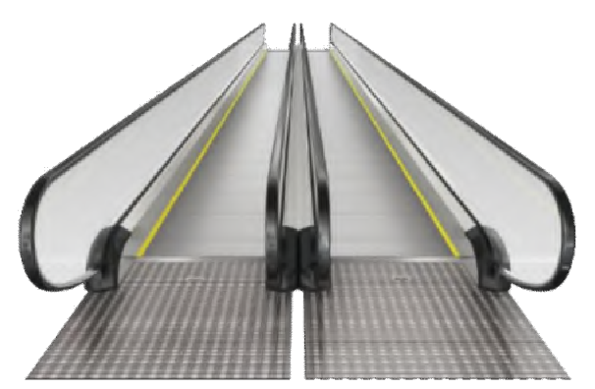
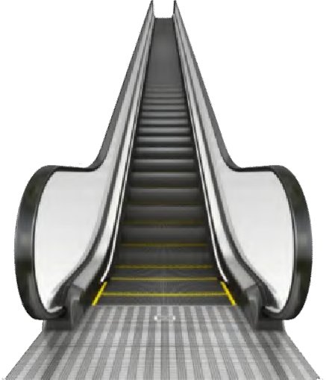
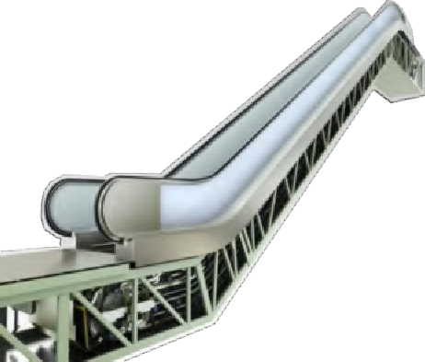
Product Range
Moving Walks
 | S900T
Max rise | 10
Inclination | 0°/10°/11°/12°
Step width | 600/800/1000
Speed | 0.5m/s
Escalators
 | Commercial escalator | Public escalator | Heavy Public escalator
 | S900E(C) | S900E(P) | S900E(H)
Max rise | 11.5m | 15m | 42m
Inclination | 30°/35° | 30°/35° | 30°/27.3°
Step width | 600/800/1000 | 800/1000 | 1000
Speed | 0.5m/s | 0.5m/s (0.65m/s optional) | 0.5m/s (0.65 optional)
S 900T
S 900E ( P )
S 900E ( C )

