Slide 1
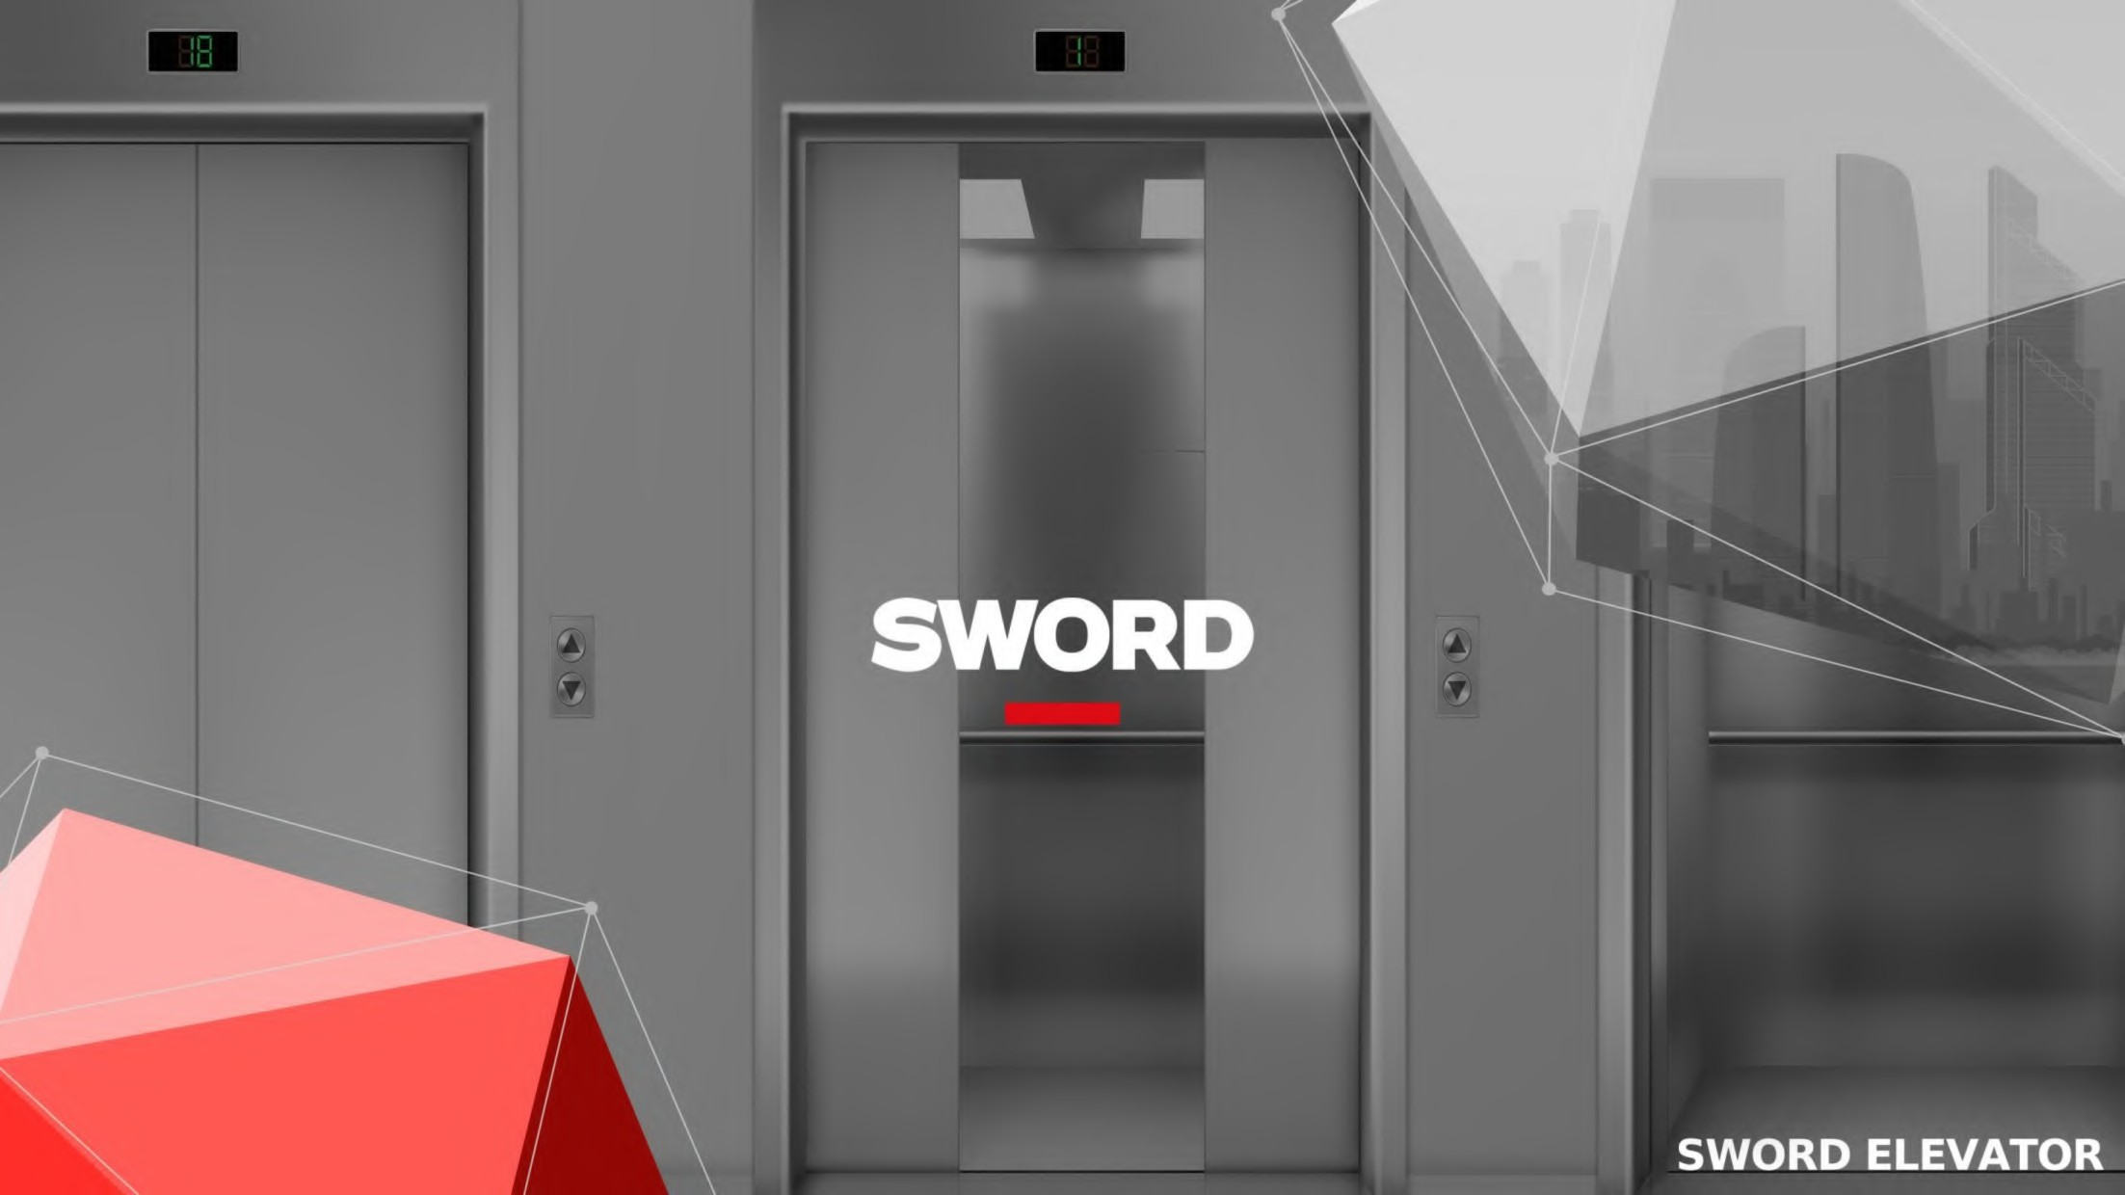



Slide 2

CONTENT
1
Company Profile
2
Product Range
3
Sales and Service
4
Classic Projects

Slide 3

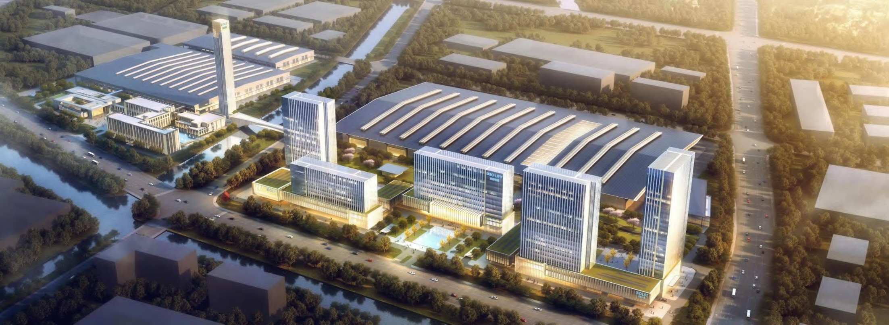
Sword Factory
Factory Area: 380,000 ㎡
Registered Capital: 81 million USD
Production Capacity: 100,000 units/year
Testing Tower: 10m/s, with a rise of 120m
Employees: 6000+

Slide 4
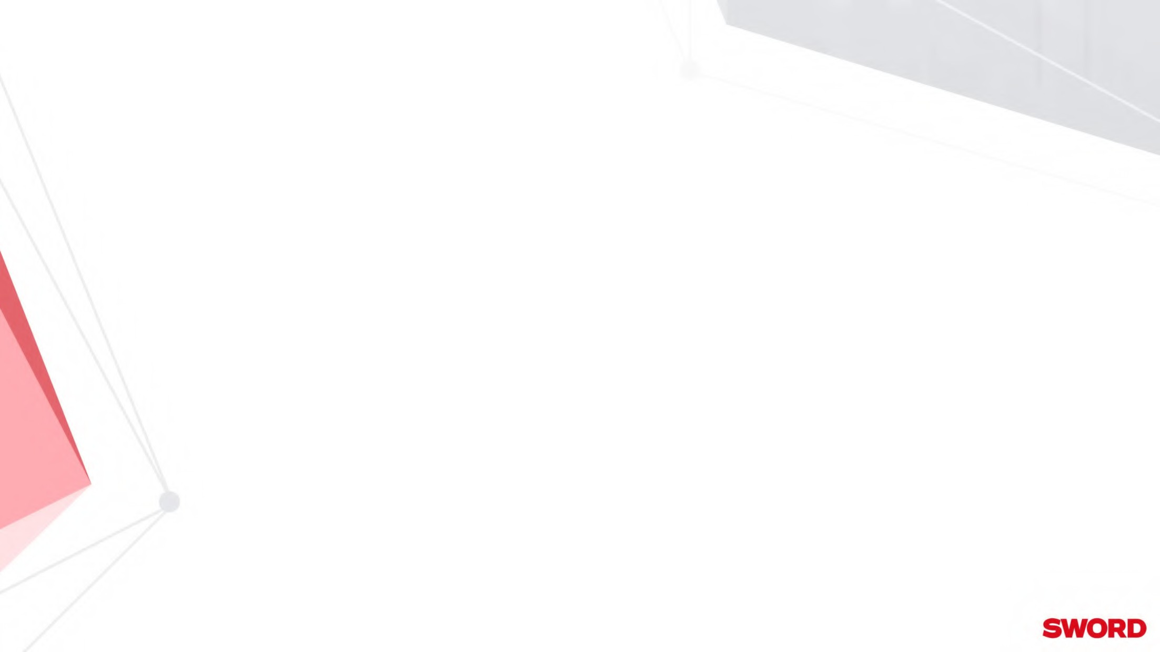

Establishment and Development
Sword officially settled
in Yuhang Economic
Products entered overseas markets.
Top 4 in the industry: sales volume (102,000 units)
Development Zone.
2004
2006
2009
2010
2013
2021
Sword Company was
International brand
SWORD established.
Sword was awarded
officially established.
"Internationally
Renowned Brand".

Slide 5
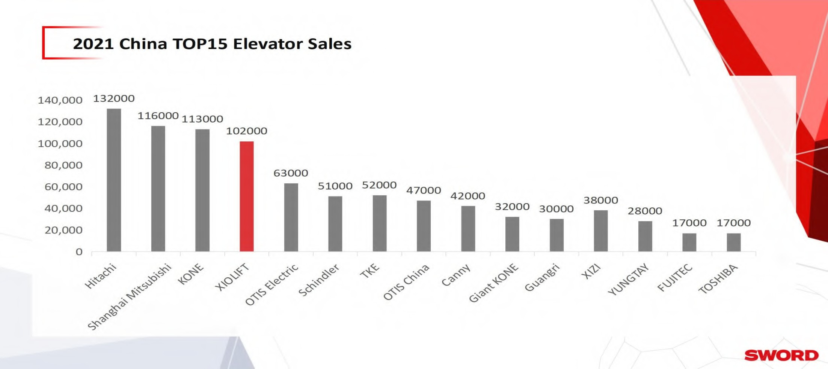

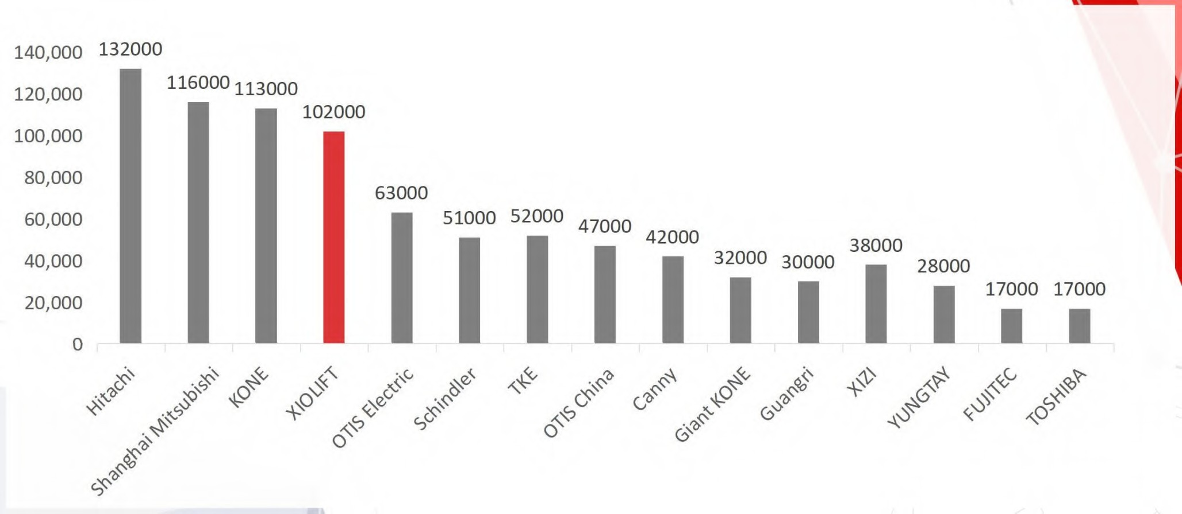
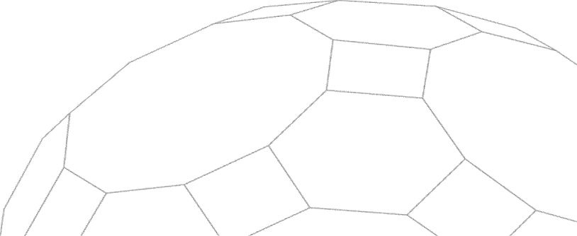
2021 China TOP15 Elevator Sales
Data from: China Elevator Association (CEA)

Slide 6

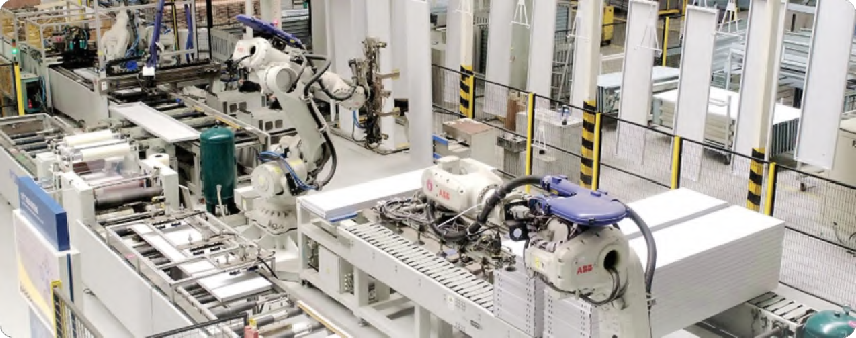
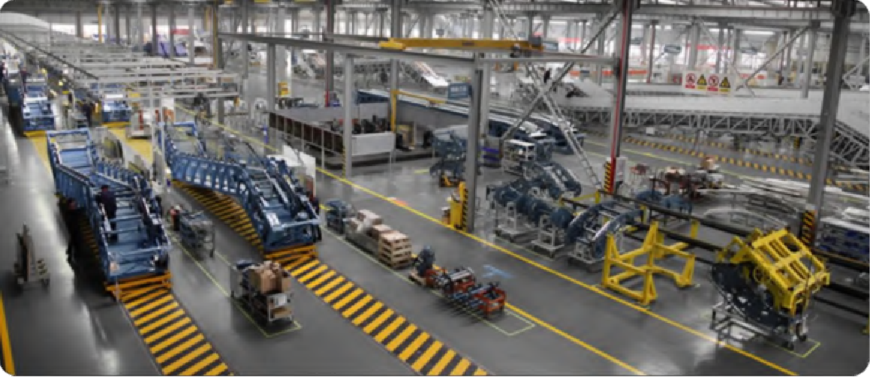
Factory
Escalator Factory Area(㎡): 50,000
Elevator Factory Area(㎡): 70,000
Production Line: 6
Capacity(unit/year): 90,000
Capacity(unit/year): 10,000

Slide 7


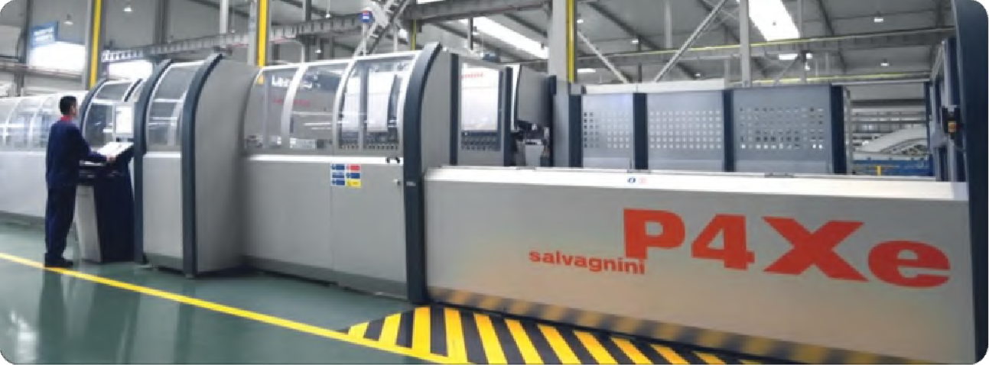

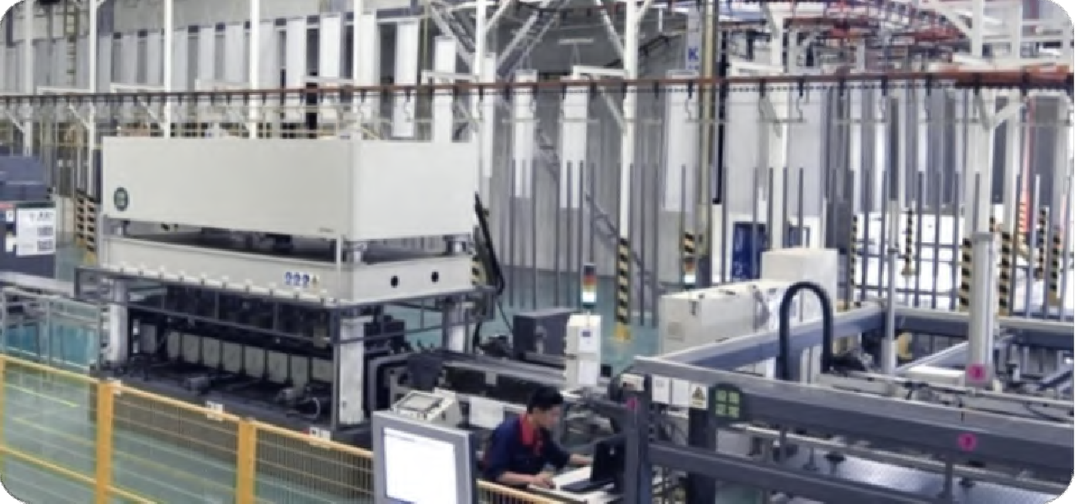
Salvagnini Flexible production line
Automatic feeding and laying-off Automatic shear center detection Automatic moving and cutting Automatic bending center detection Automatic barcode, laying-off
Factory
Fully Automatic Intelligent Sheet Line
Automatic feeding Punching Center
Long side bending center
Short side bending center

Slide 8

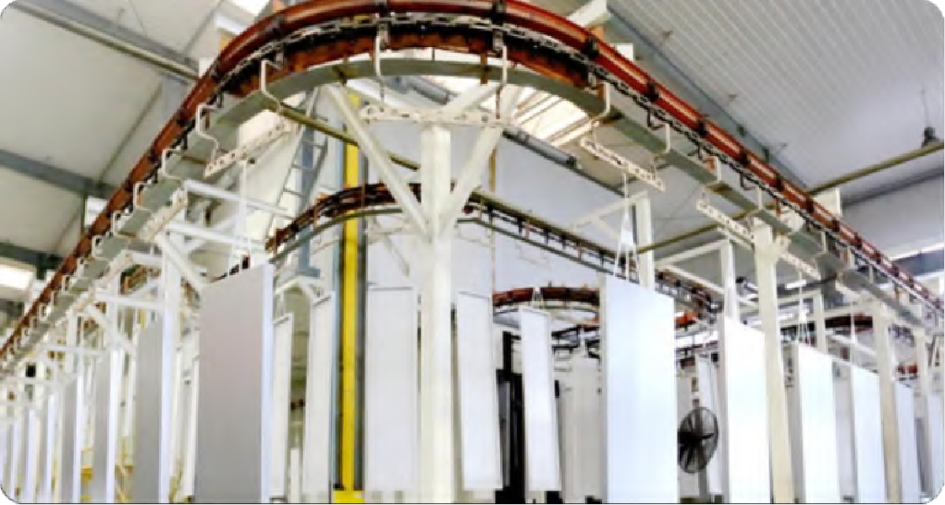
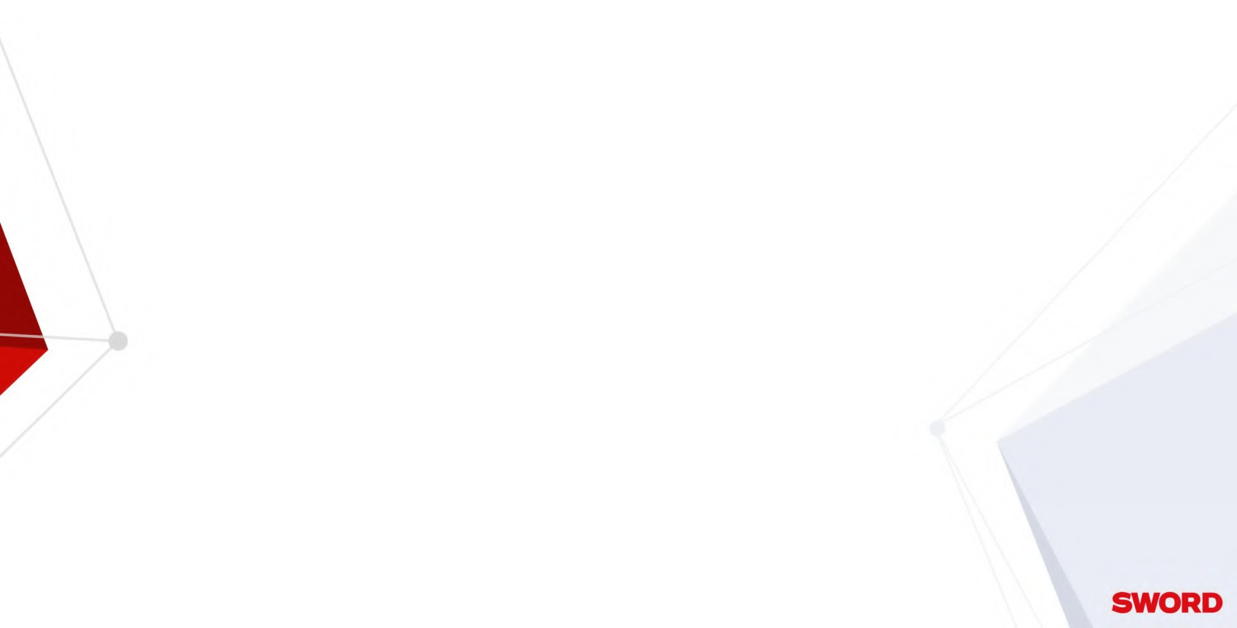

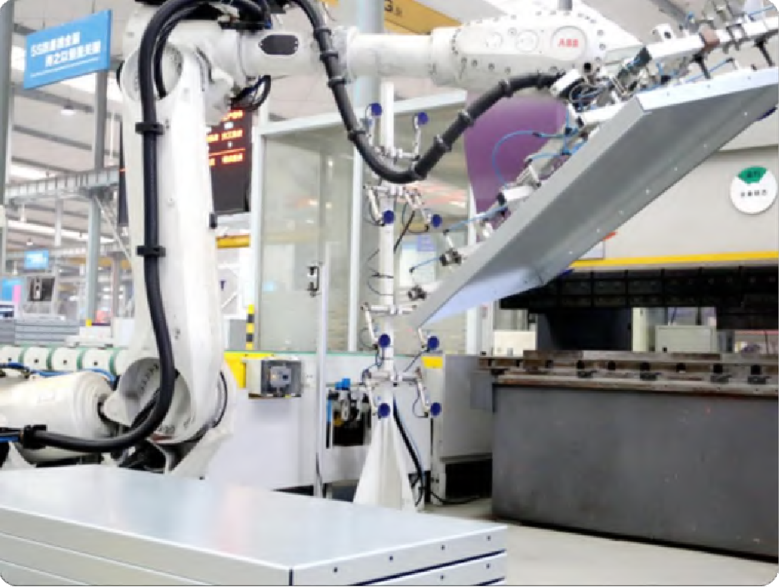

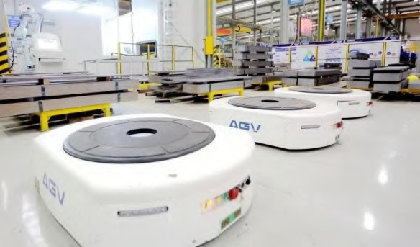
Automatic Powder Spraying line
American brand Nordson, a global leader in spraying equipment Double deck spraying line design, space-saving
Humanized design, intelligent control operation
Imported spray chamber, precise, economical and efficient
Silanization derusting, energy-saving and environment-friendly
Variable frequency transmission chain, conveyor speed can be adjusted freely
AGV
Factory
Welding Robots
ABB welding robots from Swiss
Welding tooling platform Built-in electric induction Sensing detection

Slide 9
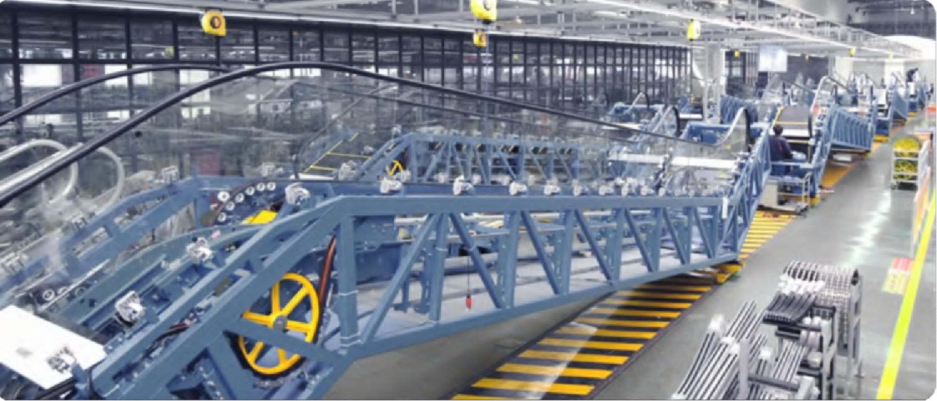


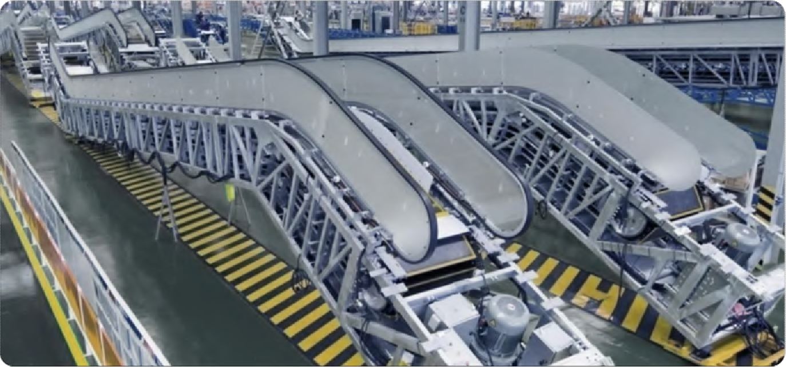

Commercial Escalator Production Line
Factory
Public Escalator Production Line

Slide 10
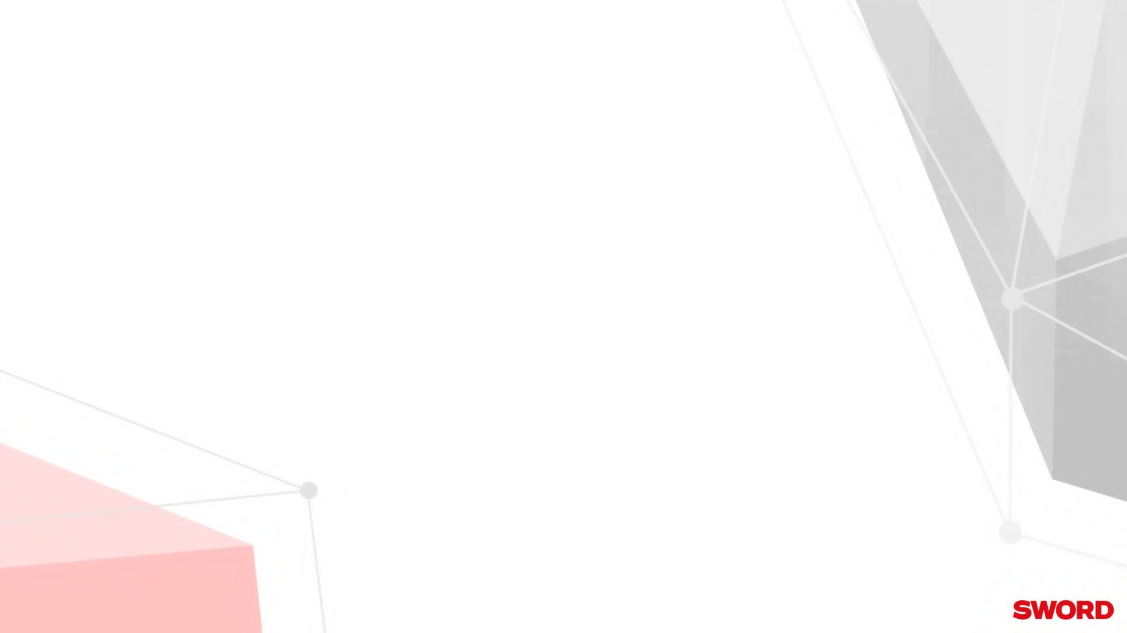
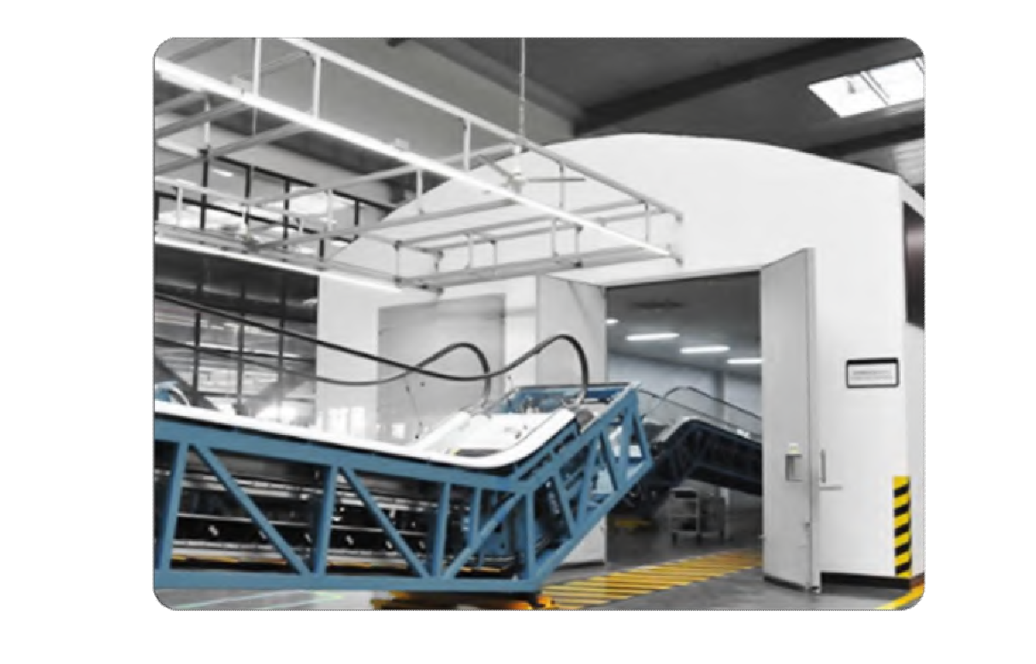

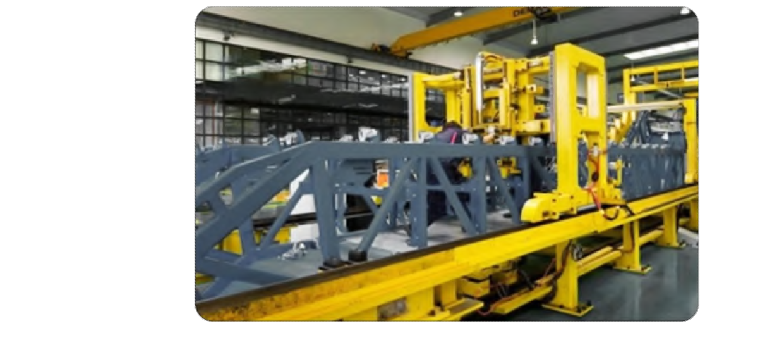

Factory
Gantry Tooling Production Line
National invention patent tooling
Up and down head positioning
Up and down large brackets installation positioning
Glass stiffener installation positioning Center guide installation positioning
Noise Testing Room
Depth 23.5m，Width 9m，
Built with environment-friendly building materials
Mute effect≤ 55db

Slide 11

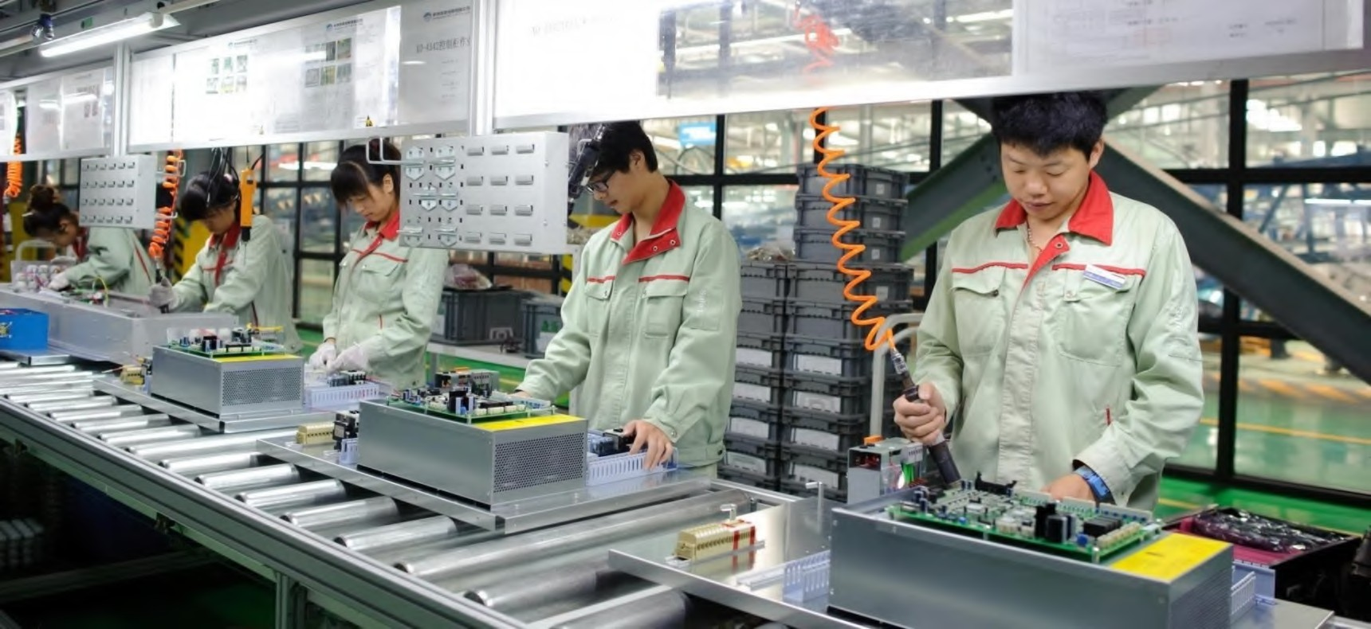

Factory
Controller Center
Elevator controller
Escalator controller
Human interface
Suspended tooling, with tools mounted in order. The workshop has wide vision and has automatic simulation test and 100% full function inspection.
Unit operation in pre-material configuration mode. The workshop has automatic simulation test and 100% full function inspection.
The workshop uses the ball flow line, the front working platform and the rear material storage, which reduces the material handling time and has automatic simulation test as well as 100% full function inspection.

Slide 12

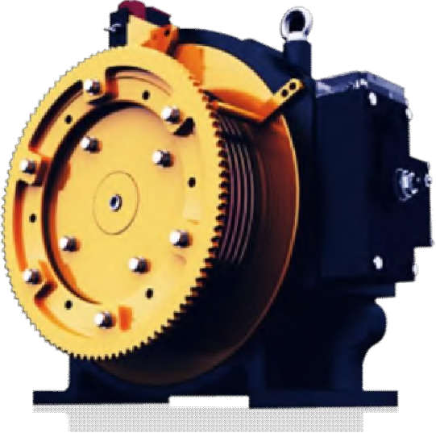
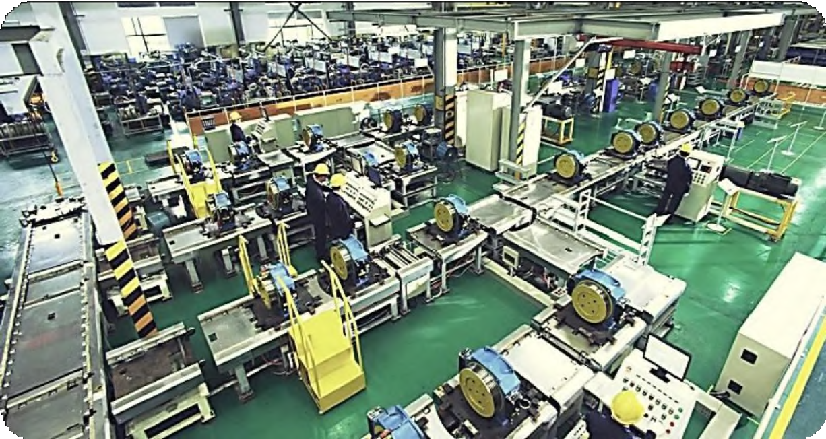

Factory
Motor Manufacturing Center
World's largest gearless traction machine production base
The global market share: 20%
On average, 1 in every 5 elevators is used

Slide 13

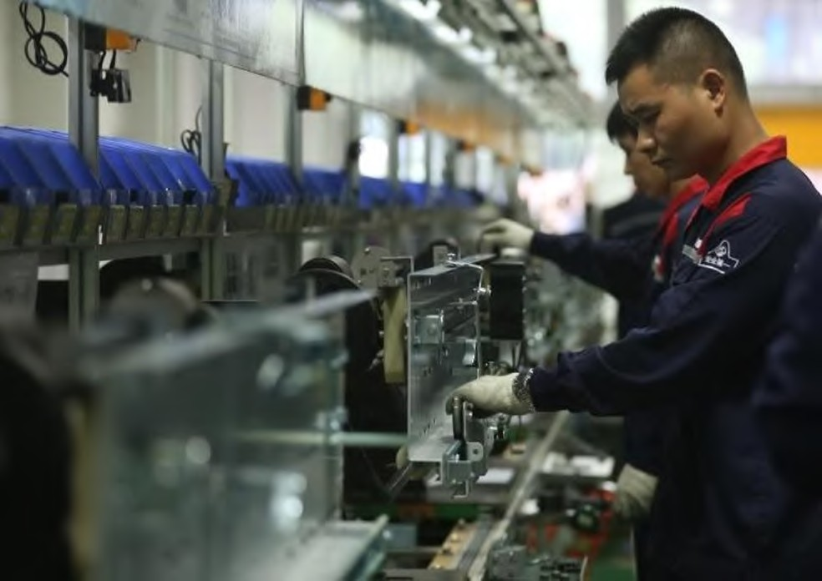

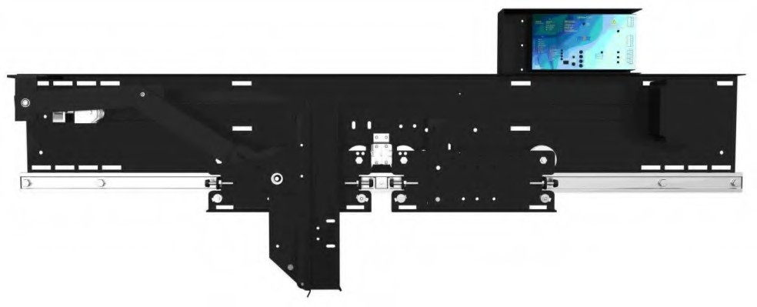
Factory
Door Operator Manufacturing Center
National laboratory
The most professional door system solution manufacturer in China

Slide 14

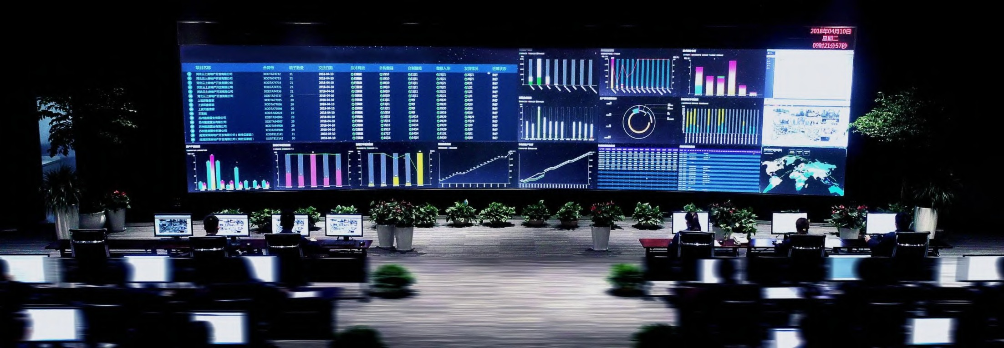

Factory
Intelligent Manufacturing Command Center
Contract scheduling requirements
Technology release status
Material arrival status
Parts production process
Product quality status
Equipment operating status
Storage situation
Overall delivery process

Slide 15
CONTENT
1
Company Profile
2
Product Range
3
Sales and Service
4
Classic Projects

Slide 16





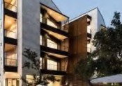
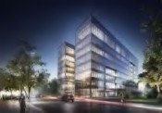
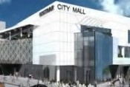
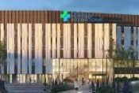
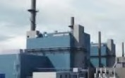
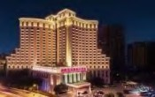

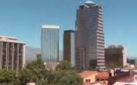


Product Range
Product Line
Sword provides the most complete product solutions.
Type Model
Product Coverage
Small Machine Room Passenger Elevator
Small Machine Room Passenger Elevator High-Speed Elevator Compact Motor MRL Passenger Elevator
WD700P
S700P
Office building
S800H
Residential
WD700MRL
Steel Belt MRL Passenger Elevator
WD800MRL
Mall
Hospital
Vertical Transportation
Steel Belt MR Passenger
Elevator
WD800MR
Industry
Hotel
Machine-Room-Less (MRL)
Passenger Elevator
S700L
Home Elevator
S800V
Public Transit
Others
Panoramic Elevator Hospital Elevator Freight Elevator
Car Elevator
Dumbwaiter Commercial/ Public Escalator
Moving Walk
S700G/S700G(MRL) S700B/S700B(MRL) S700F/S700F(MRL)
S700M
S700S
Horizontal
Transportation
S900E
S900T

Slide 17
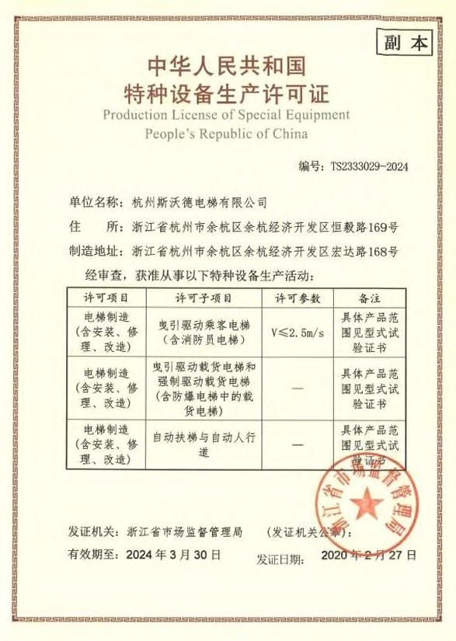

Product Range
Manufacture License
Class A
Elevator max speed 10m/s
Escalator vertical rise 42m

Slide 18

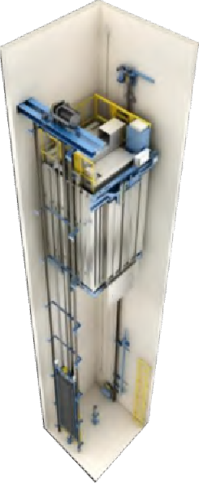
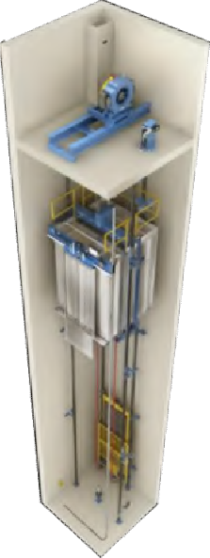
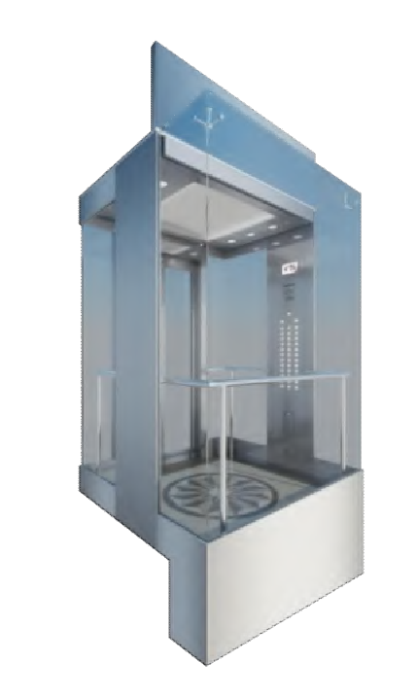

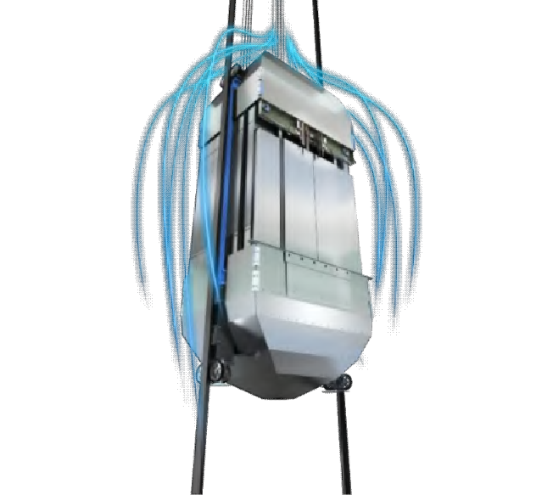
Product Range
S700L
Elevators
S700P
 | Gearless
 | S700F | S700P | S700L | S700G | S800H
 | Freight elevator | MR passenger elevator | MRL passenger elevator | Panoramic elevator | High-speed elevator
Rise | 10m-50m | 3m-150m | 3m-125m | 3m-125m | 300m
Speed | 0.25m/s-1m/s | 1m/s-3.0m/s | 1m/s-2.5m/s | 1m/s-2.5m/s | 3.5-10.0m/s
Load 1000kg-5000kg |  | 550kg-2000kg | 250kg-2500kg | 630kg-1600kg | 800kg-2000kg
S 700G
S 800 H

Slide 19



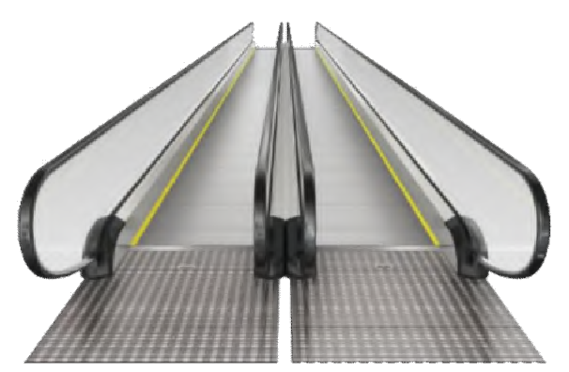
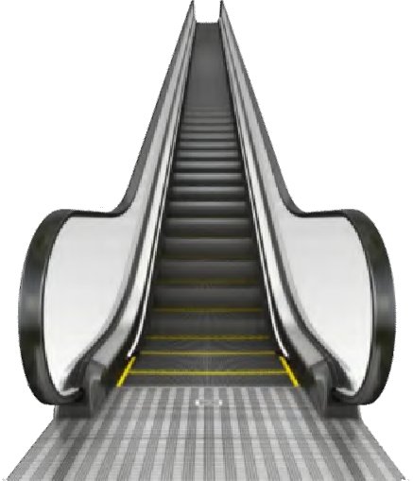
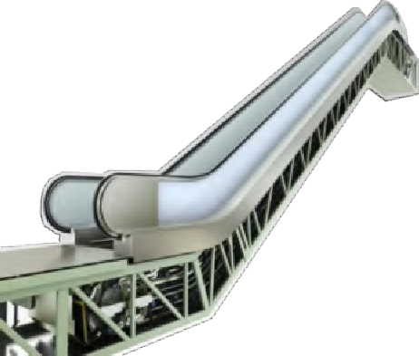
Product Range
Moving Walks
 | S900T
Max rise | 10
Inclination | 0°/10°/11°/12°
Step width | 600/800/1000
Speed | 0.5m/s
Escalators
 | Commercial escalator | Public escalator | Heavy Public escalator
 | S900E(C) | S900E(P) | S900E(H)
Max rise | 11.5m | 15m | 42m
Inclination | 30°/35° | 30°/35° | 30°/27.3°
Step width | 600/800/1000 | 800/1000 | 1000
Speed | 0.5m/s | 0.5m/s (0.65m/s optional) | 0.5m/s (0.65 optional)
S 900T
S 900E ( P )
S 900E ( C )

Slide 20

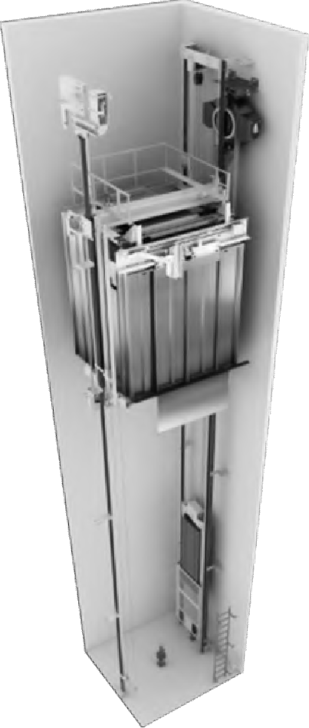
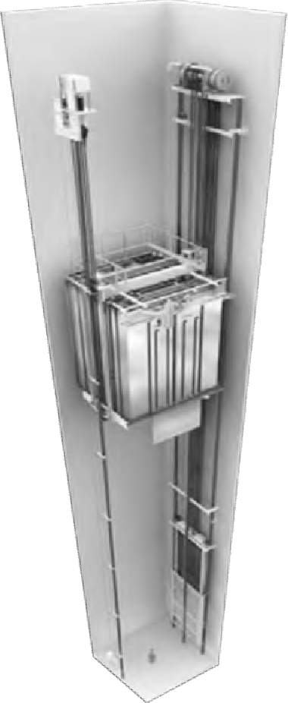
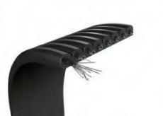
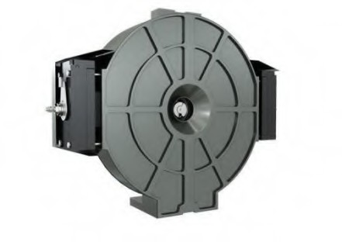
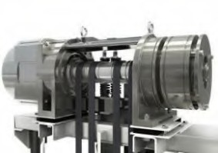




Product Range
WD800MRL
Steel Belt Elevator
Model: | WD700MRL
Load: | 450-1050kg
Speed: | 1.0-1.75m/s
Max stop : | 32
Max rise speed | 90m
Model: | WD800MRL
Load: | 450-2000kg
Speed: | 1.0-1.75m/s
Max stop: | 32
Max rise speed | 90m
WD700MRL
Compact Motor

Slide 21

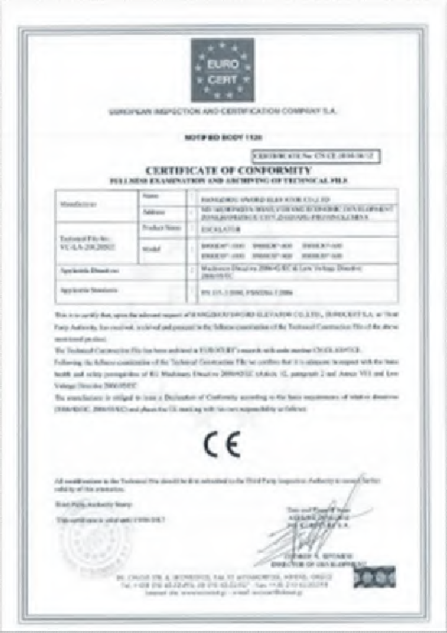
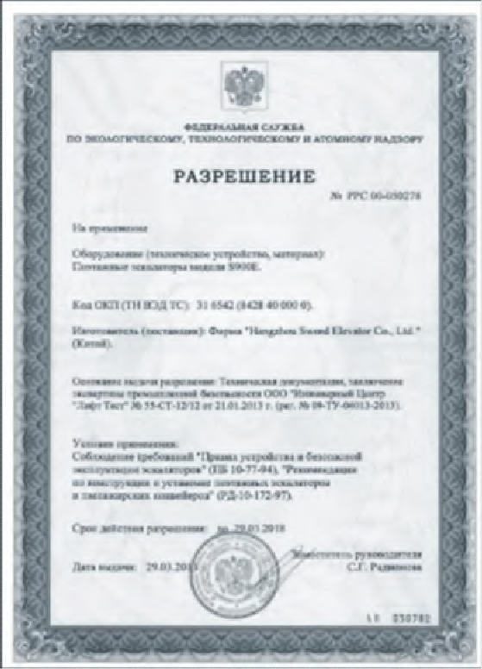
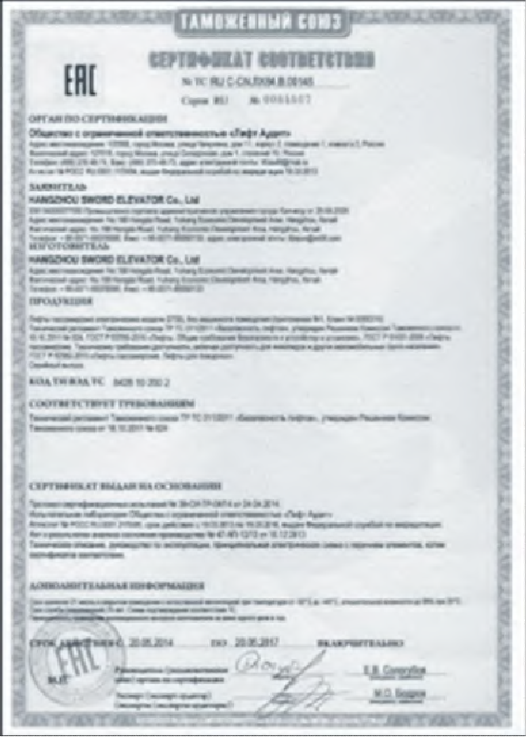
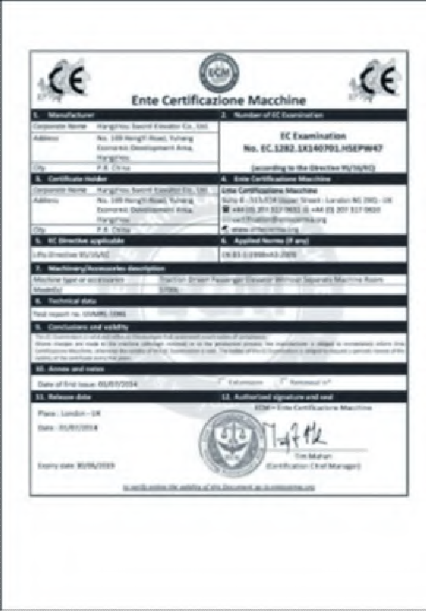
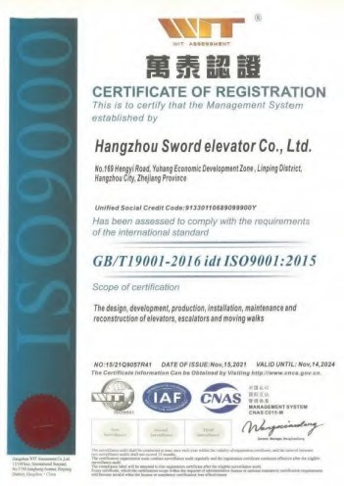


Quality System
International Certificates：
European Union CE
Russian GHOST Malaysian JKKP
ISO certificates
ISO9000 Quality Management System ISO14000 Environmental Management System
ISO45001 Health and Safety Management System

Slide 22






Test Center
Nationally Certified Electrical Test Mechanical Test

Slide 23
CONTENT
1
Company Profile
2
Product Range
3
Sales and Service
4
Classic Projects

Slide 24




Team
Pre-sales Support
Contract Technical Evaluation
Pre-sale Technical Support
Contract Process Handling
International Trade Documents Preparation
Logistics Support

Slide 25





Team
Professional technical team, rich overseas engineering experience, and perfect after-sales service system. We serve every customer efficiently and ensure the safe operation of every elevator.
After-sales service
TB Processing Center Parts Service Center
Modification Service Center
Support training
Product technical training
Commissioning & test acceptance support
Remote on-site support
Project management
Installation project management Maintenance project management

Slide 26





Project on-site training
Service System

Slide 27







Professional training services- Sword(Xiolift) University
Staff training and assessment system Advanced management training Customer training
Agent training
Service System
Overseas agent engineer training

Slide 28




Accessories Center
Service centers: 380
Accessories warehouses nationwide: 50
Headquarter warehouse area: 5,000㎡
Escalator accessories: 5,000
24/7 service
Service System

Slide 29
CONTENT
1
Company Profile
2
Product Range
3
Sales and Service
4
Classic Projects

Slide 30






Classic Projects
Public Construction
Project : Seoul Metro Line 9 Location: Seoul, Korea Units: 108
Project : Taiwan Songshan Metro Line
Project: Addis Ababa Light Rail Location: Addis Ababa, Ethiopia Units: 22
Location: Taipei, Taiwan
Units: 54
Project: Northwest Railway Station Location: India
Units: 27

Slide 31





Classic Projects
Public Construction
Project: Beijing Metro Line 1 Location: Bejing, China
Project: Hangzhou Metro Line 5 Location: Hangzhou,China
Project: Badaling Great Wall Station
Location: Beijing, China

Slide 32






Classic Projects
Public Construction
Project:: Phuket Airport, Thailand Location: Phuket, Thailand
Project : Panama Terminal
Location: Panama City, Panama
Project: Angola Kuito Airport Location: Angola
Project:Taiwan Taoyuan Airport Location: Taipei, Taiwan
Project: Kinlai Airport, Thailand Location: Thailand, Kinlay

Slide 33




Government
Classic Projects
Project: Prime Minister's Department of Malaysia Location: Kuala Lumpur, Malaysia
Units: 38
S700P,1150KG, 1.75M/S, 11/11/11
Project: Panamanian Government Location: Panama
Project: Presidential Palace of Anmara
Location: Anmara

Slide 34





Complex
Classic Projects
Project: Country Garden Forest City Location: Johor Bahru City, Malaysia Units : 20
S700L, 1600KG, 1M/S, 3/3/3
Project: Danga Bay, Johor Bahru, Malaysia Location: Johor Bahru City, Malaysia Units: 52
S700P, 1050KG, 2.5M/S, 33/33/33 S700P, 1050KG, 2M/S, 31/31/31 S700L, 2000KG, 1M/S, 2/2/2

Slide 35



Complex
Project:: Hangzhou Century Center Location: Hangzhou, China
Classic Projects
Project：Dubai Silicon Park
Location: Dubai, United Arab Emirates
Units: 92
S700L, 1600KG, 1M/S, 5/5/5 & 6/6/6 S700L, 1275KG, 1M/S, 4/4/4 & 3/3/3 S700L, 2000KG, 1M/S, 2/2/2 S700F(MRL), 2500KG, 1M/S, 2/2/2 S900E, 1000MM-30-7150MM
Project：калина молл
Location:Russia Units: 23

Slide 36





Complex
Project: Acsiopolis
Location: Johannesburg, South Africa
Units: 22
Classic Projects
Project:Central coast da nang Location: Vietnam
Units: 14
Project: Haitong City, Hong Kong Location: Uzbekistan
Units: 92
Project：Dawood Center Pic Location: Pakistan
Units: 12

Slide 37






Complex
Project: ТЦ в мира 10
Location: Krasnoyarsk，Russia
Project: EL RIO
Location: Sarama，Russia
Project: БЦ Нурлы Орда Location: Nur Sultan，Kazakhstan
Project: МТЦ Юбилейный Location: Khabarovsk，Russia

Slide 38




Hotel
Classic Projects
Project: Jewel of the Creek
Location: Dubai, United Arab Emirates Units: 79
S700L, 1000KG, 1.75M/S, 19/19/37 & 19/19/18
S700L, 1000KG, 1M/S, 7/7/7 S700L, 1600KG, 1.75M/S, 19/19/19 S900E, 1000MM-30-5500MM
Project: Mercure Indonesia
Location: Bali, Indonesia
Units: 15
Project: Centara Blue Marine Resort & Spa Location: Phuket, Thailand
Units: 8

Slide 39





Hotel
Classic Projects
Project: Sheraton Chongqing Hotel Location: Chongqing, China
Project: The Westin Chongqing Location: Chongqing, China
Project: Zaisan
Location: Ulaanbaatar,Mongolia
Project: Гранд Отель Престиж Location: Russia

Slide 40




Residential
Project: TOP NADLAN Location: Tel Aviv, Israel
Classic Projects
Units: 4
S800H, 1350KG, 4M/S , 39/39/39
Project: M point phase II
Location: Larkin, Johor Bahru, Johor，Malaysia
Units: 6+2
S800H , 1360KG , 3M/S , 35/35/35
S800H , 1360KG , 3M/S , 38/38/38

Slide 41



Residential
Classic Projects
Project: Daan Mogot City
Location: Jakarta, Indonesia
Units: 26
S700P, 1600KG, 2.5M/S , 33/33/33
Project: Global Residence
Project: Utopia Residence Location: Phuket, Thailand
Location: Dubai,
United Arab Emirates

Slide 42



Residential
Classic Projects
Project: Lebanc Cancun Locaiton: Mexico
Project: Ibiza Bay View Location: Panama City, Panama
Project: ЖК Доминант Луночарского99
Location: Perm，Russia

Slide 43




Residential
Project: Жилой дом «Легенда»
Locaiton:Perm，Russia
Project: 09:18ЖК Аулет Locaiton:Nur Sultan，Kazakhstan

Slide 44




Factory
Classic Projects
Project: TOTO Thailand Factory Location: Saraburi，Thailand
Units：11
S700F(MRL) 3000KG, 1M/S, 4/4/4 S700F(MRL) 5000KG, 0.75M/S, 3/3/3
Project:Chicony Thailand Factory
Locaiton: Chonburi, Thailand
Project: Kenpark Garment Factory
Location: Chittagong, Bangladesh
Units：22
S700F 3000KG, 1M/S, 7/7/7 Gearless
Units：35
S700F 3000KG, 1M/S, 8/8/8

Slide 45


